Slide 1
http://www.vidyanidhi.com/
ketkiacharya.net@gmail.com
Ketki Acharya
From: SM VITA ATC of CDAC
9769201036
ketkiacharya.net@gmail.com

Slide 2
What is nodeJs
As an asynchronous event-driven JavaScript runtime, Node.js is designed to build scalable network applications.
Node.js is an open source server environment.
Node.js allows you to run JavaScript on the server.
Node.js is a very powerful JavaScript-based platform built on Google Chrome's JavaScript V8 Engine.
It is used to develop I/O intensive web applications like video streaming sites, single-page applications, and other web applications. Node.js is open source.
Node.js was developed by Ryan Dahl in 2009
Node.js is a platform built on Chrome's JavaScript runtime for easily building fast and scalable network applications. Node.js uses an event-driven, non-blocking I/O model that makes it lightweight and efficient, perfect for data-intensive real-time applications that run across distributed devices.
Node.js official web site: https://nodejs.org
Node.js on github: https://github.com/nodejs/node
Node.js community conference http://nodeconf.com

Slide 3
Features of Node.js
Asynchronous and Event Driven − All APIs of Node.js library are asynchronous, that is, non-blocking. It essentially means a Node.js based server never waits for an API to return data. The server moves to the next API after calling it and a notification mechanism of Events of Node.js helps the server to get a response from the previous API call.
Very Fast − Being built on Google Chrome's V8 JavaScript Engine, Node.js library is very fast in code execution.
Single Threaded but Highly Scalable − Node.js uses a single threaded model with event looping. Event mechanism helps the server to respond in a non-blocking way and makes the server highly scalable as opposed to traditional servers which create limited threads to handle requests. Node.js uses a single threaded program and the same program can provide service to a much larger number of requests than traditional servers like Apache HTTP Server.
No Buffering − Node.js applications never buffer any data. These applications simply output the data in chunks.
License − Node.js is released under the MIT license.

Slide 4
Where to Use Node.js?
A common task for a web server can be to open a file on the server and return the content to the client.
Here is how PHP or ASP handles a file request:
Sends the task to the computer's file system.
Waits while the file system opens and reads the file.
Returns the content to the client.
Ready to handle the next request.
Here is how Node.js handles a file request:
Sends the task to the computer's file system.
Ready to handle the next request.
When the file system has opened and read the file, the server returns the content to the client.
Node.js eliminates the waiting, and simply continues with the next request.
Node.js runs single-threaded, non-blocking, asynchronously programming, which is very memory efficient.
I/O bound Applications
Data Streaming Applications
Data Intensive Real-time Applications (DIRT)
JSON APIs based Applications
Single Page Applications
Where Not to Use Node.js?
It is not advisable to use Node.js for CPU intensive applications.

Slide 5
Installation on Windows
https://nodejs.org/en/download/
Use the MSI file and follow the prompts to install the Node.js. By default, the installer uses the Node.js distribution in C:\Program Files\nodejs. The installer should set the C:\Program Files\nodejs\bin directory in window's PATH environment variable. Restart any open command prompts for the change to take effect.
Test is software running: open terminal
Create a js file named main.js on your machine (Windows or Linux) having the following code.
console.log("Hello, World!")
Now execute main.js file using Node.js interpreter to see the result −
> node main.js
If everything is fine with your installation, this should produce the following result −
Hello, World!

Slide 6
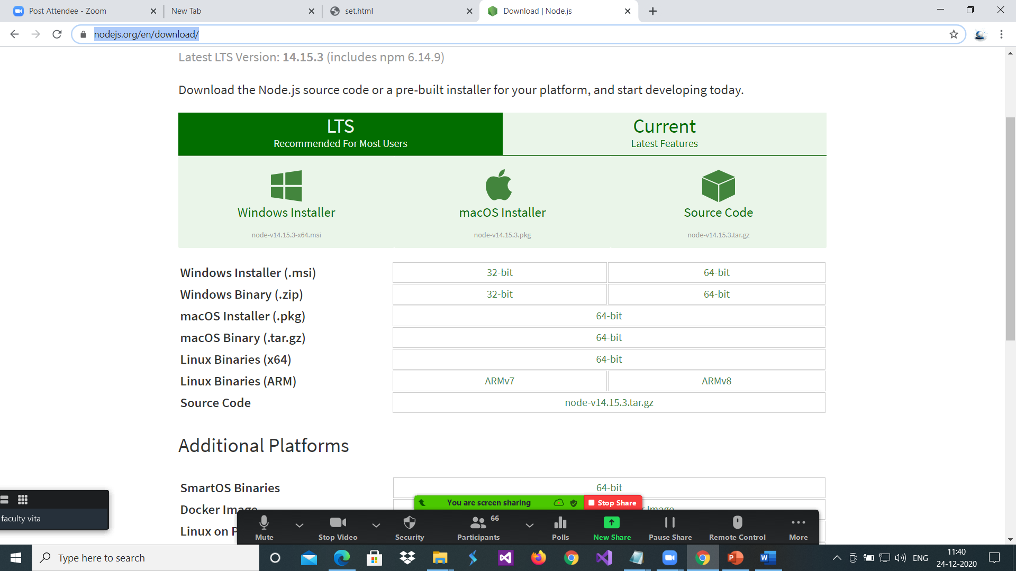

Slide 7
A Node.js application consists of the following three important components −Demo1
Import required modules − We use the require directive to load Node.js modules.
Create server − A server which will listen to client's requests similar to Apache HTTP Server.
Read request and return response − create a server that will read the HTTP request made by the client which can be a browser or a console and return the response.
Step 1 - Import Required Module
We use the require directive to load the http module and store the returned HTTP instance into an http variable as follows −
var http = require("http");
Step 2 - Create Server
We use the created http instance and call http.createServer() method to create a server instance and then we bind it at port 8081 using the listen method associated with the server instance. Pass it a function with parameters request and response. Write the sample implementation to always return "Hello World".
//file 02.js
var http = require("http");
http.createServer(function (request, response) {
// Send the HTTP header // HTTP Status: 200 : OK // Content Type: text/plain
response.writeHead(200, {'Content-Type': 'text/plain'});
// Send the response body as "Hello World"
response.end('Hello World\n');
}).listen(8081); // Console will print the message
console.log('Server running at http://127.0.0.1:8081/');
Open command prompt
Visit the location of file
>node 02.js
In browser
http://localhost:8081

Slide 8
How to change port number
const http = require('http');
const hostname = '127.0.0.1';
const port = 3000;
const server = http.createServer((req, res) => {
res.statusCode = 200;
res.setHeader('Content-Type', 'text/plain');
res.end('Hello World\n');
});
server.listen(port, hostname, () => {
console.log(`Server running at http://${hostname}:${port}/`);
});

Slide 9
What is http
As mentioned before, web servers accept requests from browsers and other clients.
We may interact with a web server by entering a domain name, which is translated to an IP address by a DNS server.
An IP address is a unique sequence of numbers that identify a machine on a network,
like the internet. The value localhost is a special private address that computers
use to refer to themselves. It’s typically the equivalent of the internal
IP address 127.0.0.1 and it’s only available to the local computer,
not to any local networks we’ve joined or to the internet.
The port is a number that servers use as an endpoint or “door” to our IP address.
In our example, we will use port 8081 for our web server. Ports 8080 and 8081 are typically used as default ports in development, and in most cases developers will use them rather than other ports for HTTP servers.
When we bind our server to this host and port, we will be able to reach our server by visiting http://localhost:8000 in a local browser.
To use the HTTP server and client one must require('http').
The HTTP interfaces in Node.js are designed to support many features of the protocol which have been traditionally difficult to use.
In particular, large, possibly chunk-encoded, messages.
The interface is careful to never buffer entire requests or responses, so the user is able to stream data.
HTTP message headers are represented by an object like this:
{ 'content-length': '123',
'content-type': 'text/plain',
'connection': 'keep-alive',
'host': 'mysite.com',
'accept': '*/*' }
Put this line in code
Console.log(http)
You will see all methods and property of HTP class

Slide 10
http.createServer([options][, requestListener])
options <Object>:IncomingMessage <http.IncomingMessage> Specifies the IncomingMessage class to be used. Useful for extending the original IncomingMessage. Default: IncomingMessage.
ServerResponse <http.ServerResponse> Specifies the ServerResponse class to be used. Useful for extending the original ServerResponse. Default: ServerResponse.
insecureHTTPParser <boolean> Use an insecure HTTP parser that accepts invalid HTTP headers when true. Using the insecure parser should be avoided. See --insecure-http-parser for more information. Default: false
maxHeaderSize <number> Optionally overrides the value of --max-http-header-size for requests received by this server, i.e. the maximum length of request headers in bytes. Default: 16384 (16KB).
requestListener <Function>
Returns: <http.Server>
Returns a new instance of http.Server.

Slide 11
What is req, res in anonymous function
http.createServer(function (request, response) {
})
All request listener functions in Node.js accept two arguments: req and res (we can name them differently if we want).
The HTTP request the user sends is captured in a Request object, which corresponds to the first argument, req.
The HTTP response that we return to the user is formed by interacting with the Response object in second argument, res.
response.writeHead(200, {'Content-Type': 'text/plain'});
// Send the response body as "Hello World"
response.end('Hello World\n’);
res.writeHead(200); sets the HTTP status code of the response. HTTP status codes indicate how well an HTTP request was handled by the server. In this case, the status code 200 corresponds to "OK".
response.end('Hello World\n’);
res.end("My first server!");, writes the HTTP response back to the client who requested it. This function returns any data the server has to return. In this case, it’s returning text data.

Slide 12
server.listen() method.
It accepts three arguments: port, host, and a callback function that fires when the server begins to listen.
Starts the HTTP server listening for connections
res.end('Hello World\n');
res.end() was called. With http. response() one must always call res.end() to signify the end of the request - even if there is no data being written to the request body.

Slide 13
What is modules
Consider modules to be the same as JavaScript libraries.
A set of functions you want to include in your application.
Node.js has a set of built-in modules which you can use without any further installation. Ex. http is built in module [var http = require('http’);]
var http = require('http');
var dt = require(‘./03module');
http.createServer(function (req, res) {
res.writeHead(200, {'Content-Type': 'text/html'});
res.write("The date and time are currently: " + dt.myDateTime());
res.end();
}).listen(8080);
//file03modul.js
exports.myDateTime = function () {
return Date();
};
Extra notes
Module.exports={}
Moduule.exports={myDateTime}
Notice that we use ./ to locate the module, that means that the module is located in the same folder as the Node.js file.

Slide 14
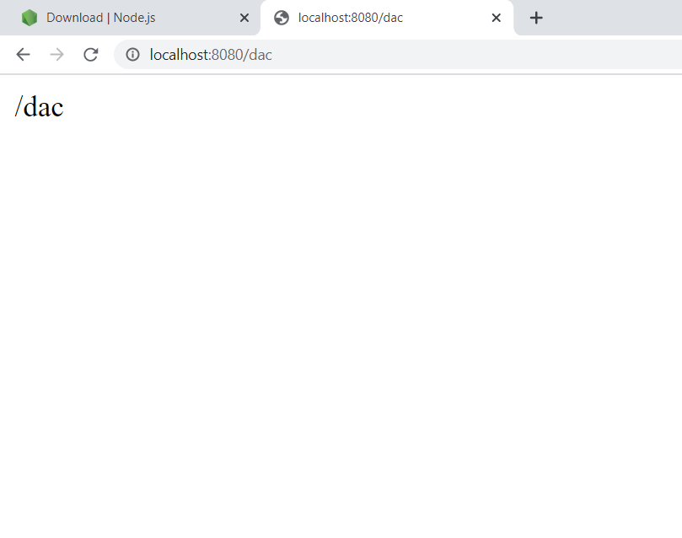
Read the Query String
the function passed into the http.createServer() has a req argument that represents the request from the client, as an object (http.IncomingMessage object).
This object has a property called "url" which holds the part of the url that comes after the domain name:
//05url.js
var http = require('http'); http.createServer(function (req, res) { res.writeHead(200, {'Content-Type’ : 'text/html'}); res.write(req.url); res.end(); }).listen(8080);
Run code : type in url
http://localhost:8080/dac

Slide 15
Split the Query String There are built-in modules to easily split the Query String There are built-in modules to easily split the query string into readable parts, such as the URL module.
var http = require('http'); var url = require('url'); http.createServer(function (req, res) { res.writeHead(200, {'Content-Type': 'text/html'}); var q = url.parse(req.url, true).query; var txt = q.year + " " + q.month; res.end(txt); }).listen(8080);
{
year=2017
month=July
}
http://localhost:8080/?year=2017&month=July
Will produce this result:
2017 July
Parse an address with the url.parse() method, and it will return a URL object with each part of the address as properties:

Slide 16
url.parse(urlString[, parseQueryString[, slashesDenoteHost]])
urlString <string> The URL string to parse.
parseQueryString <boolean> If true, the query property will always be set to an object returned by the querystring module's parse() method. If false, the query property on the returned URL object will be an unparsed, undecoded string. Default: false.
slashesDenoteHost <boolean> If true, the first token after the literal string // and preceding the next / will be interpreted as the host.
For instance, given //foo/bar, the result would be {host: 'foo', pathname: '/bar'} rather than {pathname: '//foo/bar'}. Default: false.
The url.parse() method takes a URL string, parses it, and returns a URL object.
A TypeError is thrown if urlString is not a string.
A URIError is thrown if the auth property is present but cannot be decoded.

